Slide 1


Investigating Effects on Tesla stock
Patrick Elles & Samuel Constante
DSE200 – Fall 2025

Slide 2
Tesla Stock Data Frame Compared to Tesla News and Elon Musk’s Tweets
Background
We both recognized that Tesla's stock price is significantly influenced by Elon Musk's public statements and media coverage surrounding the company.
Our goal was to identify specific language and press coverage, if any, drives these stock price movements.
Research questions
Which terms used in article titles or Elon’s twitter posts have the greatest impact on Tesla share price?
Can Tesla be trusted as a stable, rising stock?

Slide 3
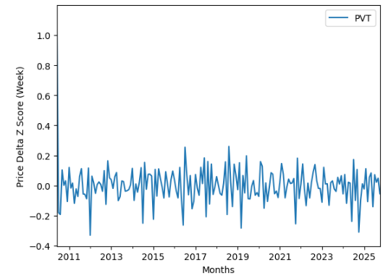
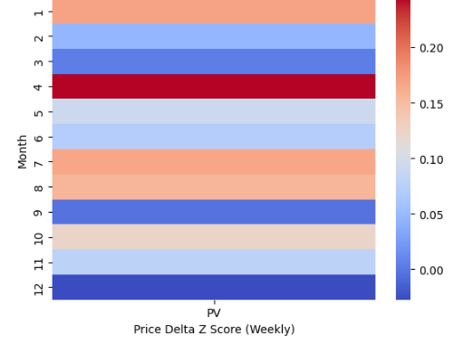
Tesla Stock Data Frame
Background
Captures the share price from 2010 to 2025
Includes only days where trading occurred
Captures the volatile rise of Tesla's share price through the early 2000s
Insights
Tesla share price change is very unpredictable and drastic
Change is often correlated with quarterly reports and earning calls
Tesla has been gradually dominating the stock market, but it is far from a blue-chip stock because of its volatility
There is a proven correlation between terminology and stock change

Slide 4
News Articles Data Frame
Background
Our Tesla news article data frame was formed from an RSS feed which feeds into common stock interfaces.
Information that was gathered was the titles of Tesla news articles stemming back to 2013.
Goal
Aggregate all the titles for their corresponding date and merge those with our stock data frame to find possible correlations between article language and stock price movements.

Slide 5
Elon Musk’s Tweet DF
Background
Elon Musk's tweet data was collected from his official account (@elonmusk) spanning from the very beginning through April 13, 2025.
The dataset includes both main tweets and quote tweets, compiled from multiple Kaggle datasets covering different time periods (2010-2025).
Goal
Merge Musk's tweet data with Tesla stock prices by date to identify whether controversial tweet content correlates with same-day stock price movements.

Slide 6
Stock Data Frame (Feature Engineering)
Problem
Share price details give daily price change but lack information on price direction and annual movement.
Solution
Create a suite of functions that would aggregate the data for a given date and merge it to our correlating data frame.

Slide 7
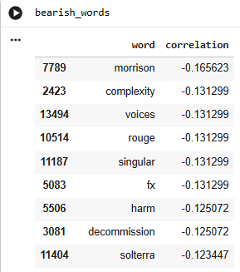
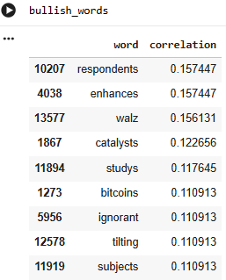
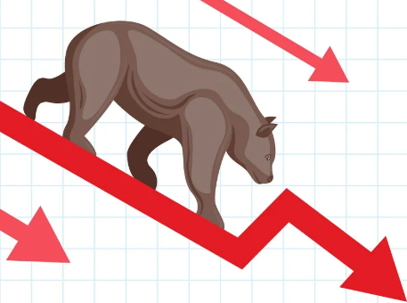

News Article Correlation Results (Price Delta)

Slide 8
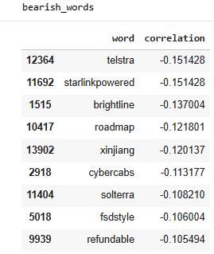
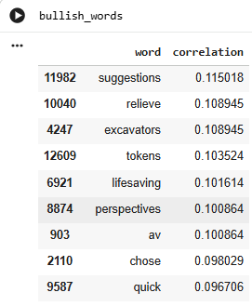
News Article Correlation Results (Price Next Day Delta)

Slide 9
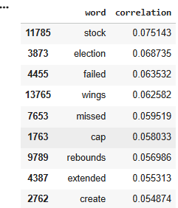
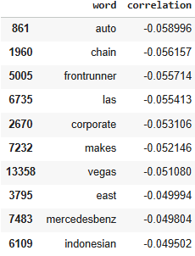
News Article Correlation Results (Volume Z-Score / Weekly)
Positive
Negative

Slide 10
Musk Tweet Feature Engineering
Controversial Tweet Classification
Identify tweets likely to impact investor sentiment by Keyword matching on tweet text
Keywords include: "funding secured", "stock price”, "profitable", "demand", "coming soon“, and others
Keywords used were based on known SEC violations and Musk's history of market moving statements
Stock manipulation
Short seller attacks
Full self driving promises
Production hype
Profitability
Hype

Slide 11
Musk Tweets Hypothesis Testing:
Do controversial tweets move Stock price?
Analysis Approach:
Compare “controversial” tweets vs normal tweets on trading days, measuring same day stock returns
Perform a samples t-test that compares the mean returns between the two groups
Tests whether the difference is statistically significant or just due to chance
Results:
T-statistic: 1.2 → How many std dev apart are two groups? (t > 2 indicates significant difference)
P-value: .196 → Probability the difference is due to random chance (p < .05 indicates significant)
Poor statistical evidence that controversial tweets correlate with larger stock movements

Slide 12
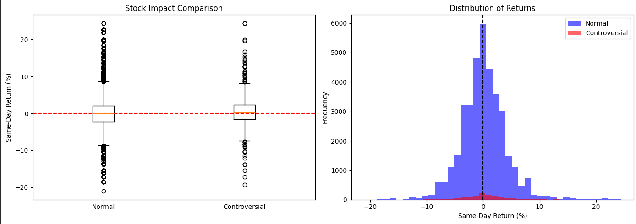
Tweet & Stock Correlation Findings
Research Question: Do Elon Musk's controversial tweets correlate with same day Tesla stock price movements?
NO - Controversial tweets do not significantly correlate with larger stock movements
Controversial tweets: 0.41% avg same day return
Normal tweets: 0.19% avg same day return
2.1x larger stock movements on controversial tweet days

Slide 13
Goal: Categorize news events by sentiment and analyze how they affect stock insights (Samuel Constante) as well how they affect stock insights combined with controversial tweets from Elon’s Twitter account (Patrick Elles)
Final Project Phase 2
The stock/news titles data frame and the newly merged stock/tweet/news title data frames were analyzed by a sentiment machine learning model. (siebert/sentiment-RoBERTa-large-english)
All titles and dates were given their own row set in this process to gather more meaningful insights.
Data was aggregated to consider days where there were multiple articles and/or tweets, so results weren’t skewed

Slide 14
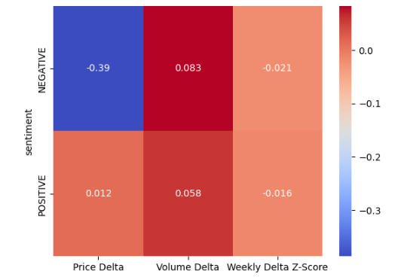
Phase 2: Insights ( Stock Delta / News Sentiment )
Insights from our sample dataset show that negative news titles have a higher effect on daily price change, weekly volume trade, and weekly price volatility.
Negative news is more impactful on the health of Tesla stock then positive.

Slide 15
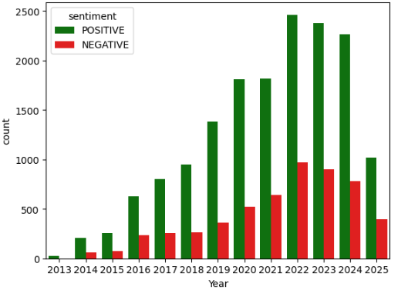
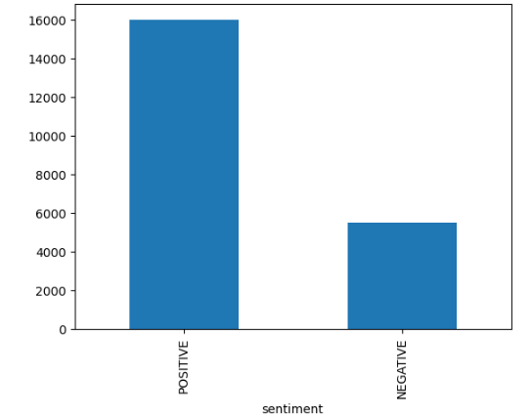
Phase 2: Insights (News Sentiment Trends)
Tesla has more positive sentiment; however, the negative sentiment is more impactful.

Slide 16
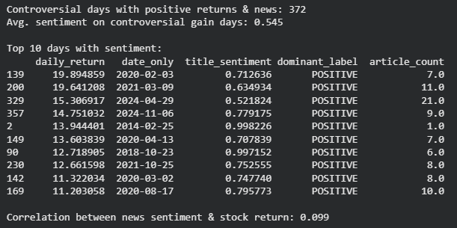
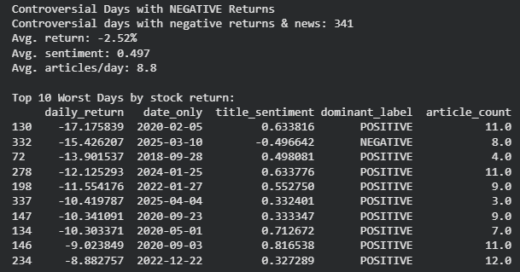

Phase 2: Insights (Stock Delta/ News Sentiment/ Tweets)
Controversial tweet days with positive returns showed moderately positive sentiment (0.545), while negative return days showed slightly less positive sentiment (0.497)
Weak correlations (0.099 and 0.082) indicate sentiment has minimal predictive power for stock direction
9 out of 10 worst crash days still featured positive headlines, which could be because news articles still have an optimistic tone regardless of stock performance
Only 1 crash day (3/10/25: -15.4%) showed negative sentiment, demonstrating financial media's consistently positive framing about Tesla

Slide 17
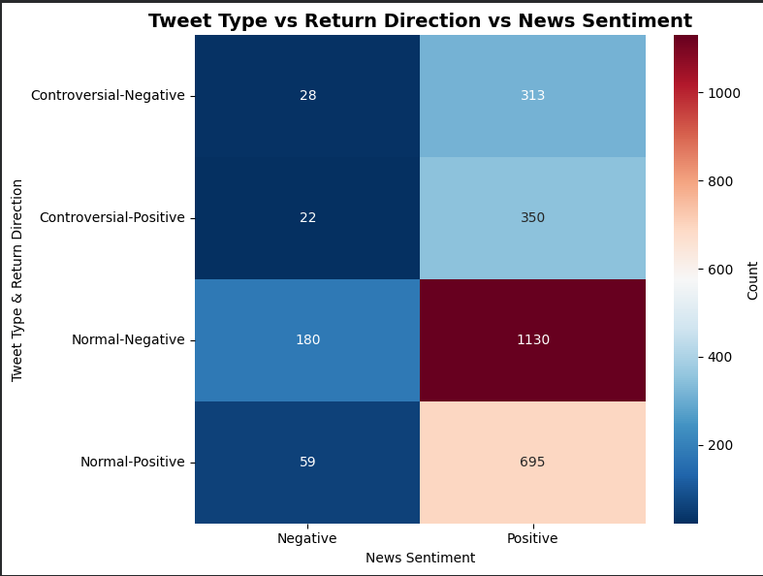
Phase 2: Insights (Stock Delta/ News Sentiment/ Tweets)
News sentiment is positive 90%+ of the time regardless of tweet type or stock direction
Controversial tweet days show fewer negative articles (7%) than normal days (13%), suggesting they often coincide with genuinely positive business developments
Sentiment distribution is remarkably similar across all conditions, which confirms that article sentiment does not predict stock movements

Slide 18
Phase 2 Findings: Stock Movements Compared to Elon’s Tweets & News Sentiment
Initial Finding: Tweet level analysis showed controversial tweets correlate with 4.6x larger stock movements (0.41% vs 0.09%, p = 0.0016).
Robustness Check: Day level analysis revealed the effect was inflated by multiple tweets per day. When controlling for this the difference dropped to 2.2x and lost statistical significance (p = 0.195).
Phase 2 -News Analysis: Controversial days with news coverage averaged 2.95% returns vs 1.55% without news, suggesting media attention drives movements more than tweets alone. News sentiment was consistently positive (0.52 average) regardless of stock direction, showing minimal predictive value.
Conclusion: While controversial tweets correlate with elevated returns at the tweet level, this relationship is not statistically significant when accounting for multiple tweets per day and appears partially driven by concurrent news coverage rather than tweets alone. Media attention volume matters more than tweet content or sentiment tone.

